Slide 1





DISPUTE BOARDS:
Wedding rings or marriage chains?
Adriana Spassova
Partner EQE Control OOD, ABS Group
FIDIC Accredited Adjudicator & Module 1 Trainer
DRBF Region 2 (incl. ECA) Board Director & Bulgaria CR
Bulgarian Society of Construction Law Chair

Slide 2


Adriana Spassova DISPUTE BOARDS: Wedding rings or marriage chains?
What is a Dispute Board?
A creature of the contract, established as an ADR device in action during the project implementation:
“The term ‘dispute board’ is a generic term that includes (a) the dispute review board, which is a device that originated in the USA (and continues to be used most often there) and which provides non-binding recommendations; (b) the dispute adjudication board, which emerged from the earlier USA model, and which provides a decision that has interim-binding force and which is used most everywhere else in the world except the USA; and (c) the combined dispute board (CDB), which is a hybrid of dispute review boards and dispute adjudication boards and was created by the ICC in 2004. Various other terms have been used, such as dispute settlement panel, dispute mediation board, dispute avoidance panel, dispute resolution board, and dispute conciliation panel. Fundamentally these different varieties of dispute review devices are the same, each providing early adjudication based on the contractual bargain between the parties.”
Cyril Chern, Chern on Dispute Boards: Practice and Procedure (Informa Law Third Ed 2015 eISBN: 978-1-315-75661-5) 41

Slide 3
Adriana Spassova DISPUTE BOARDS: Wedding rings or marriage chains?
What is the story of the Dispute Boards?
The Dispute Resolution Board Foundation (DRBF) has gathered information about the use of Dispute Boards since 1982.
The data shows the depth and breadth of the process being used worldwide for numerous types of projects of varying size.
The database available online includes about 3000 projects in all continents:
https://drb.org/publications-data/drb-database/

Slide 4
Adriana Spassova DISPUTE BOARDS: Wedding rings or marriage chains?
1975
The first DB was used on the second bore of I-70 Eisenhower Tunnel
1992
FIDIC issued the DAB Supplement to the 4th Ed Red Book
1995
The World Bank made DBs mandatory for its projects with value above 50 m $
1999
FIDIC introduced the DAB: standing for Red Book & ad hoc for Yellow & Silver Books
2006
9 Multilateral Development Banks adopted DBs, incorporated in the FIDIC Pink Book
ICC introduced DB rules
2004

Slide 5
Adriana Spassova DISPUTE BOARDS: Wedding rings or marriage chains?
The DRBF statistics shows the DB success:
Over 98% of matters going to the DB do not go on to later arbitration or litigation.
In case the disputes are refereed to arbitration/ litigation, the DB determination is considered as reliable expert evidence and confirmed in most cases.

Slide 6
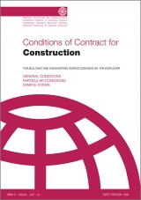
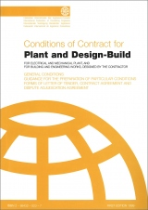
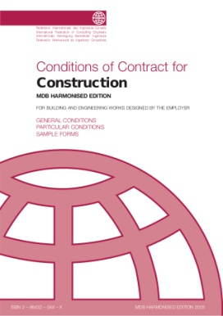
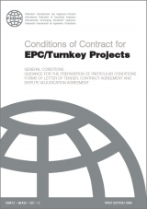
Adriana Spassova DISPUTE BOARDS: Wedding rings or marriage chains?
How are the Dispute Boards in the FIDIC Conditions of Contract working?
In the 1999 Books for major projects FIDIC included the dispute adjudication procedure:
SC 20.2: “Disputes shall be adjudicated by a DAB in accordance with Sub-Clause 20.4”.
Standing DAB Ad hoc DAB

Slide 7
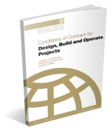
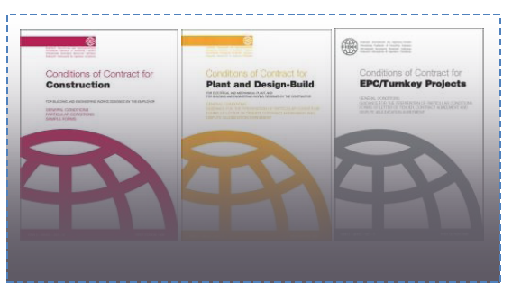
Adriana Spassova DISPUTE BOARDS: Wedding rings or marriage chains?
2008 Gold Book:
1 or 3 member standing DAB before the Commissioning Certificate;
1-person standing Operation Service DAB for a 5y term;
may be reappointed or new appointments follow in the next 5y terms.
Pending 2017 Edition of the Red, Yellow & Silver Books: a standing DAAB
(Dispute Avoidance/Adjudication Board pursuant to Clause 1.1.23 of the Pre-release Second Edition 2017 of the Yellow Book issued for the FIDIC Users Conference in London in 2016).

Slide 8
Adriana Spassova DISPUTE BOARDS: Wedding rings or marriage chains?
FIDIC DAB procedures
Clause 20 GC
SC 20.2 [Appointment of the Dispute Adjudication Board]
Appendix to GC
General Conditions of Dispute Adjudication Agreement
Annex 1 to DAA GC
Procedural Rules
SC 20.3 [Failure to Agree Dispute Adjudication Board]
SC 20.4 [Obtaining Dispute Adjudication Board's Decision]
SC 20.7 [Failure to Comply with Dispute Adjudication Board's Decision]
SC 20.8 [Expiry of Dispute Adjudication Board's Appointment]

Slide 9
Adriana Spassova DISPUTE BOARDS: Wedding rings or marriage chains?
The DRBF statistics shows the DB success:
Over 98% of matters going to the DB do not go on to later arbitration or litigation.
In case the disputes are refereed to arbitration/ litigation, the DB determination is considered as reliable expert evidence and confirmed in most cases.

Slide 10
Adriana Spassova DISPUTE BOARDS: Wedding rings or marriage chains?
Payment
As DAB Decision
As agreed
Yes
As ruled
Yes
No
No
Referral to
DAB
DAB
decision
Satisfied?
NOTICE of Dissatisfaction
Amicable Settlement
Arbitration
84d
28d
Min 56d

Slide 11

Adriana Spassova DISPUTE BOARDS: Wedding rings or marriage chains?
Why do the couples to be married spend time and money for the wedding rings?
The wedding rings are important to those planning to wed. Many couples invest large amounts of time in the selection of rings.
Gold is the preferred material, though not the cheapest. The meaning of gold is illumination, wisdom, and wealth. Gold often symbolizes high quality.
The round infinite form symbolizes the perfection in the relations.
The wedding rings are symbols of the love, friendship, and faithfulness that the couple will share.
The rings demonstrate the union that has already taken place: a promise to be true in good times and in bad.

Slide 12
Adriana Spassova DISPUTE BOARDS: Wedding rings or marriage chains?
Can the Dispute Boards be regarded as wedding rings??
Yes, if selected carefully and established as a standing DB at the outset of the project:
The GURU:
  The experienced DB shall explain the contractual procedures and possible pitfalls;
  The inquisitorial DB shall ask questions to point the problems and carefully guide the Parties to solve the potential disagreements;
  The persuasive DB shall explain the parties that they can use his advice and jointly refer for opinions for difficult interpretations or other escalating disagreements.

Slide 13
Adriana Spassova DISPUTE BOARDS: Wedding rings or marriage chains?
The GUARDIAN of the relationships:
  The impartial DB shall influence the parties not to fall down the slope of adversarial correspondence;
  The presence of the DB familiar with the project shall restrain the Employer from pressing the Engineer to reject all Contractor’s claims;
  The objective DB makes useless any attempt of the Contractor to corrupt the Engineer.
  The proactive DB shall simplify all procedures and invite joint referral for opinion during the site visits and meetings, cooling the negative emotions with his reasons.

Slide 14
Adriana Spassova DISPUTE BOARDS: Wedding rings or marriage chains?
The RELATIVE always ready to help:
  The DB is part of the project administration: he is checking the contemporary records on a quarterly basis during the site visits, if not every month;
  The DB members are professionals with decades of experience with similar projects and contracts, restricted from interference in the project execution and supervision, but clever enough to find a way to point out potential risks and give advice (asking questions or proposing the parties further tests, meetings, negotiations, etc).
  The DB is supportive - always ready to advice about meeting the funders’ requirements in case of variations, unforeseeable events and delayed payments.
  The DB is economic: its cost is less than 1% of the project budget and even if the adversarial culture of the parties is predominant, the DB shall sort the numerous referrals, deal quickly with the easy straightforward ones to cool the passions, explain the parties how devastating may be the arbitration/litigation for the project, their relationships and their pockets. As a result, at least 50% of the disputes shall be solved, all contemporary records shall be sorted and analysed and the DB determinations shall be recognised as reliable expert evidence in further dispute resolution procedures.

Slide 15


Adriana Spassova DISPUTE BOARDS: Wedding rings or marriage chains?
Can the Dispute Boards be regarded as marriage chains?
Yes, if appointed in the end of the project against the will of one party.
Chains do not hold a marriage together….

Slide 16

Adriana Spassova DISPUTE BOARDS: Wedding rings or marriage chains?
The Banks: Is there anybody out there?
It is very strange why most of MBDs are negligent about the establishing of the DB at the outset of the project!
The funders give their “no objection” to the tender documents and selection of the contractor and wash their hands… They are not interested how the DB can be financed and whether it is established as agreed under the contract…
This is a strange behaviour, taking into account, that the adjudication has been implemented by the World Bank for several decades!

Slide 17
Adriana Spassova DISPUTE BOARDS: Wedding rings or marriage chains?
Number of DB members: 1 or 3?
Luckily, JICA (the Japan International Cooperation Agency) is out there! “JICA recognizes the DB as a mechanism for sound contract management rather than conflict settlement procedures, and deems the cost for the DB eligible to be financed by the Loan.”
JICA, DB Manual (version 1.0, March 2012) iv, https://www.jica.go.jp/activities/schemes/finance_co/procedure/guideline/pdf/DisputeBoardManual_201203_e.pdf
Estimate of total cost of DB
Inclusion of the total cost of DB at appraisal
Inclusion of 1/2 estimated cost of DB as a Provisional Sum in BQ for use of Invitation to Tender
Prior to Award, review of build-up of Provisional Sum; Employer, Engineer, Contractor to participate
DB members submit invoices for fees and expenses to Contractor
Contractor will be paid 1/2 of payment to DB members by Employer
Contractor pays 100% of fees and expenses to DB members

Slide 18
Adriana Spassova DISPUTE BOARDS: Wedding rings or marriage chains?
The DAAB – at last FIDIC has done it right!
An ounce of prevention is worth a pound of cure!!!
The DAAB: Dispute Adjudication Avoidance Board shall be the wedding ring in the new 2017 edition of the FIDIC 1999 Red, Yellow and Silver Books!
Relying on the preliminary information from the Yellow Book December 2016 Pre-Release version, the new edition not only corrects the mistake with the ad-hoc DAB in the 1999 Yellow and Silver Books:
The Employer’s and Contractor’s claims are grouped together in Clause 20;
A new Clause 21 is created for disputes, thus demonstrating, that the Contractor’s claim notification is an early warning, important for the risk management; it is not an adversarial act leading to disputes;
Clause 21 implements the modern more certain provisions of the 2008 Gold Book, emphasizing the preventive function of the DAB.

Slide 19

Adriana Spassova DISPUTE BOARDS: Wedding rings or marriage chains?
Conclusions:
Secure the budget for the golden wedding rings, made in your style, looking forward to harmonious and lasting partnering!
The impartial DB experienced in similar projects is the key to success!
Carefully select the wedding rings: Whatever your choice of FIDIC Conditions of Contract, use the 2017 FIDIC Clause 21, deriving from the Gold Book and further strengthening the preventive function of the DB, in order to have the standing DAAB as a project management instrument!
Live happily ever after!!!

Slide 20
Adriana Spassova DISPUTE BOARDS: Wedding rings or marriage chains?
Adriana Spassova
Mobile: +359 888 464928
email: aks@eqe.bg

